Slide 1



DONE BY - JULIAN IMPERIAL N01638310
SEN0189
TURBIDITY SENSOR
FOR PHYTOPLANKTON AIR SYSTEMS
WWW.MYSENSOR.COM

Slide 2

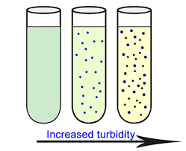
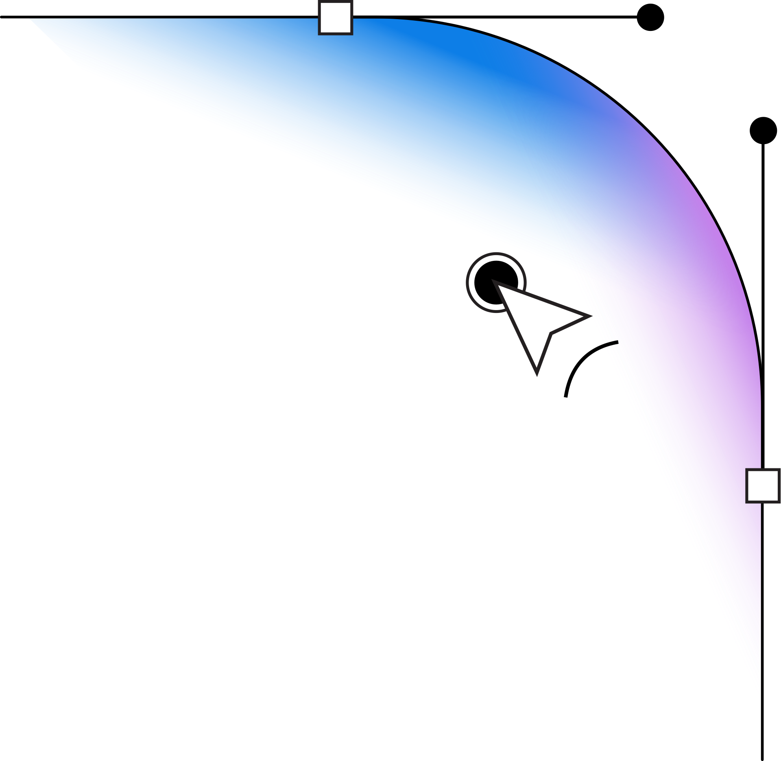
HARDWARE PRODUCTION TECH - CENG-317-0CA
WWW.MYSENSOR.COM
SENSOR - OVERVIEW
Low-cost analog turbidity sensor that detects water quality by measuring the turbidity (cloudiness) caused by suspended particles, like algae.
Works by emitting infrared light into the water and measuring the scattering of that light
More particles = more scattering = higher turbidity.

Slide 3

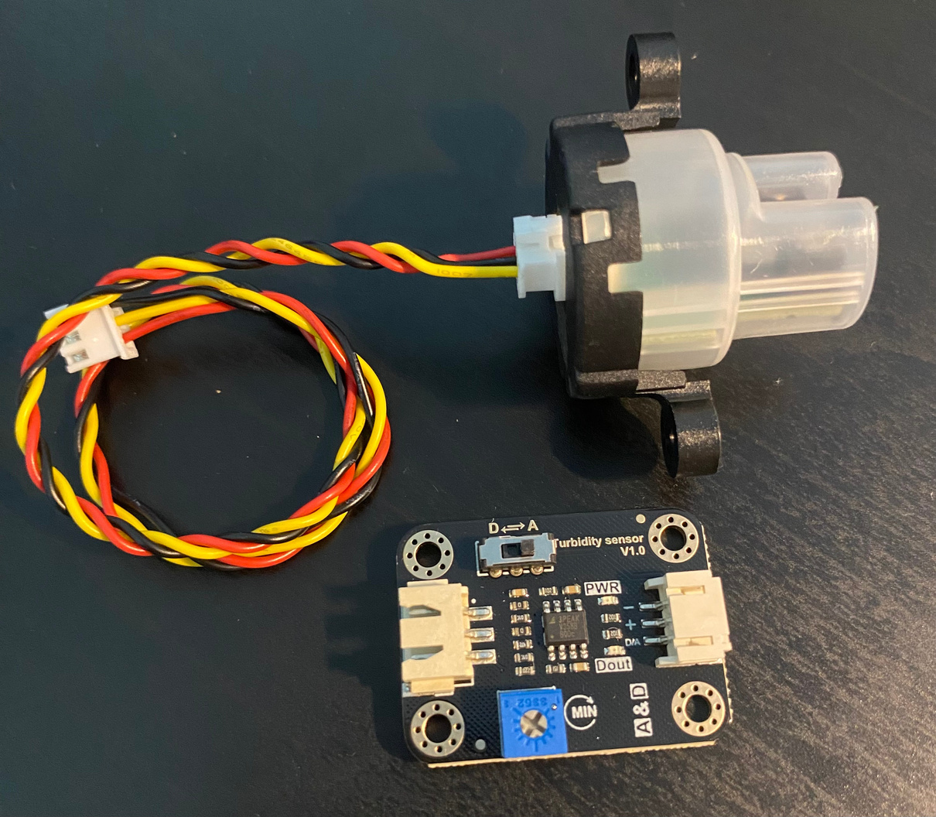
HARDWARE PRODUCTION TECH - CENG-317-0CA
THE SENSOR
ANALOG - SEN0189 DFROBOT
WWW.MYSENSOR.COM

Slide 4

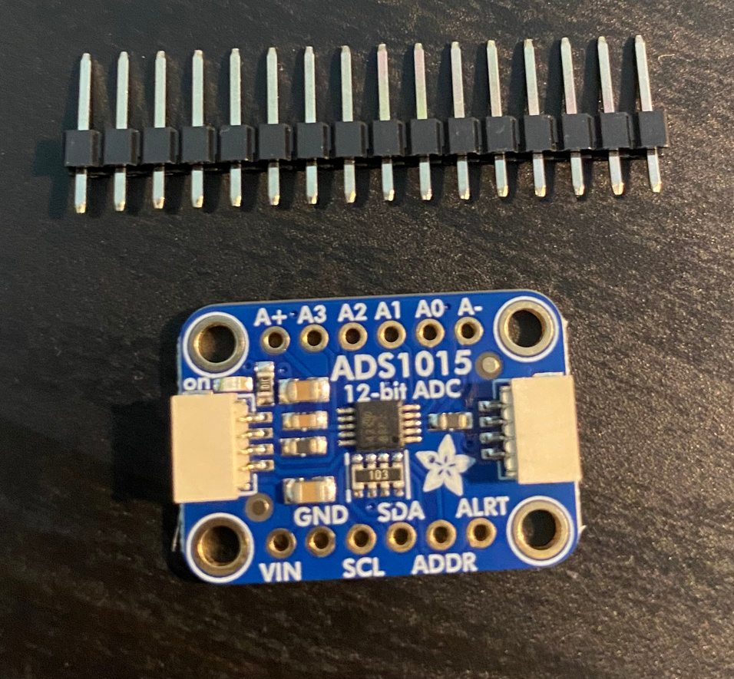
HARDWARE PRODUCTION TECH - CENG-317-0CA
THE ADC CONVERTER
ADS1015
I2C ADDRESS - 0X48
WWW.MYSENSOR.COM

Slide 5
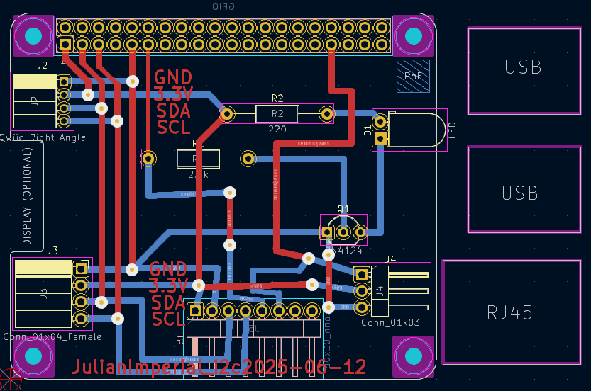
THE KICAD SCHEMATIC

Slide 6
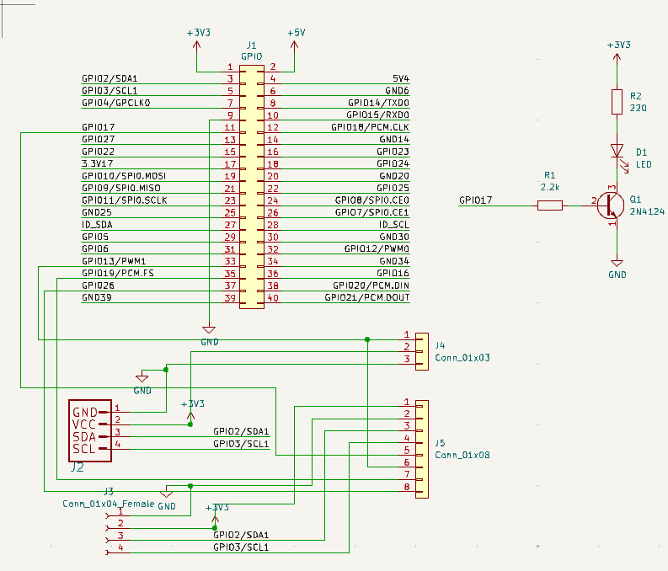
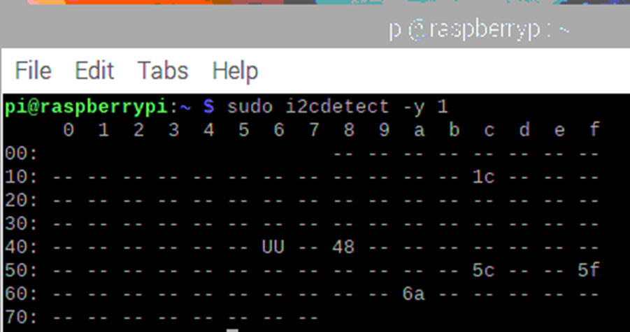
THE SCHEMATIC AND ADDRESS 2

Slide 7
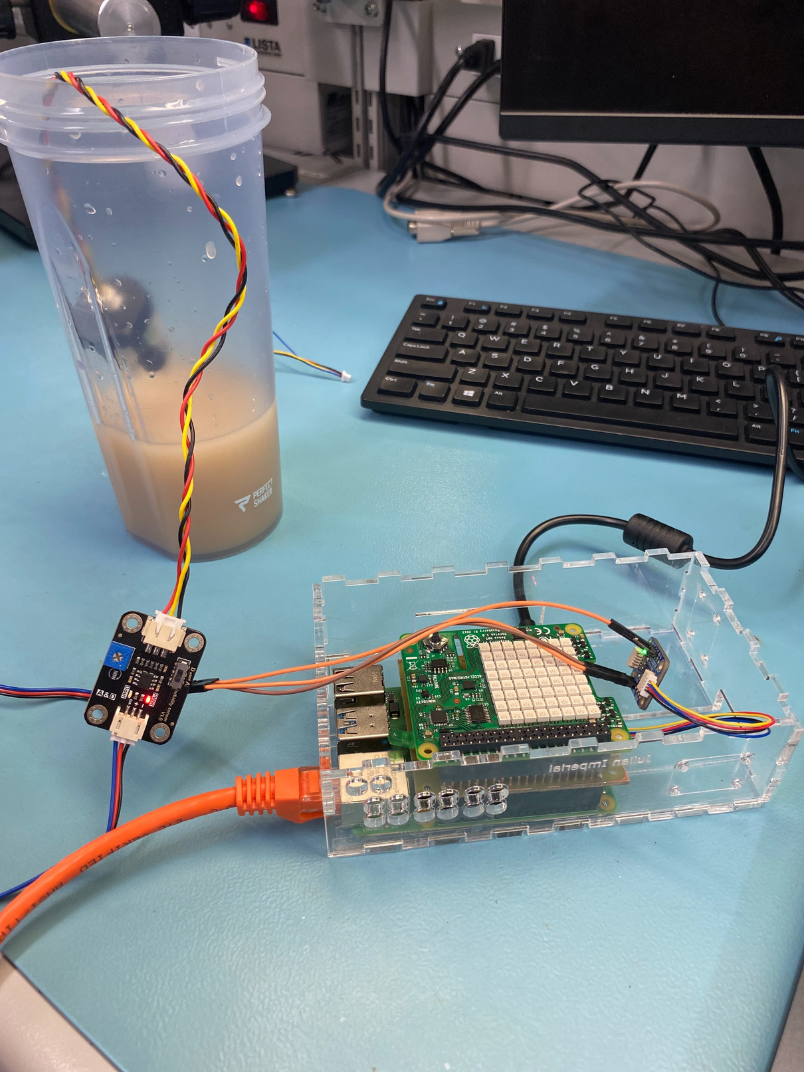
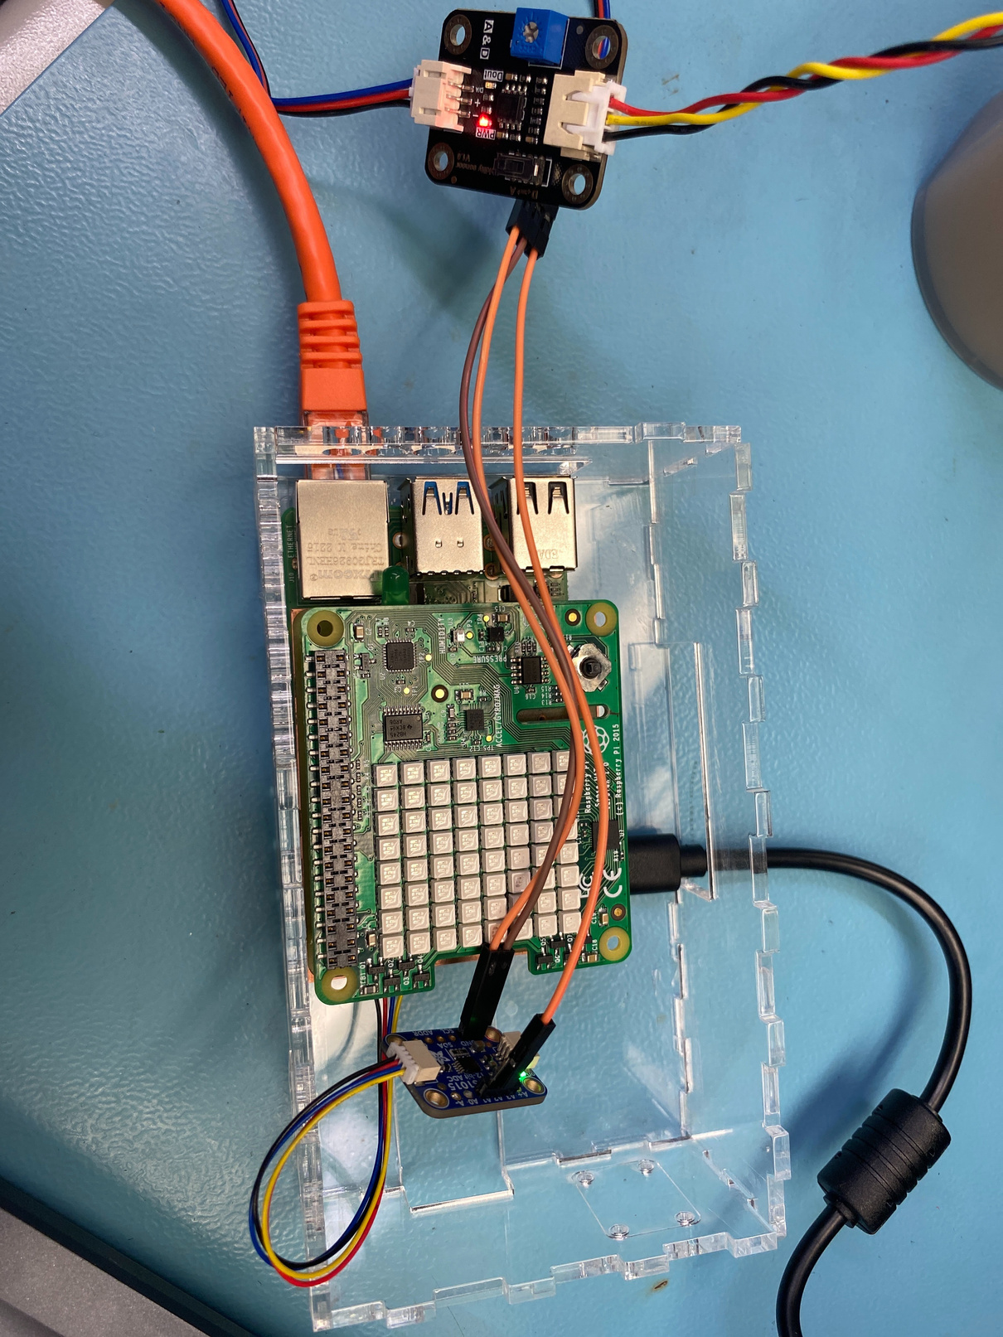
ASSEMBLED PROJECT

Slide 8
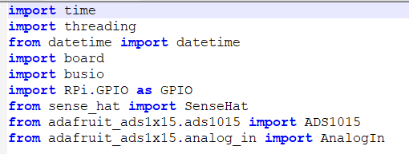
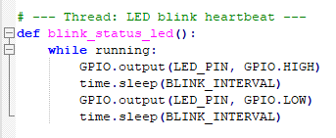
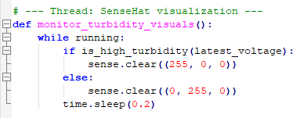
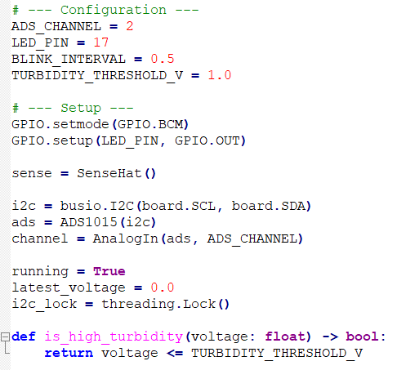
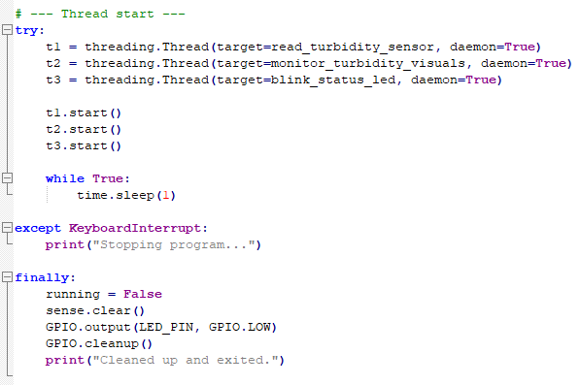
THE CODE

Slide 9
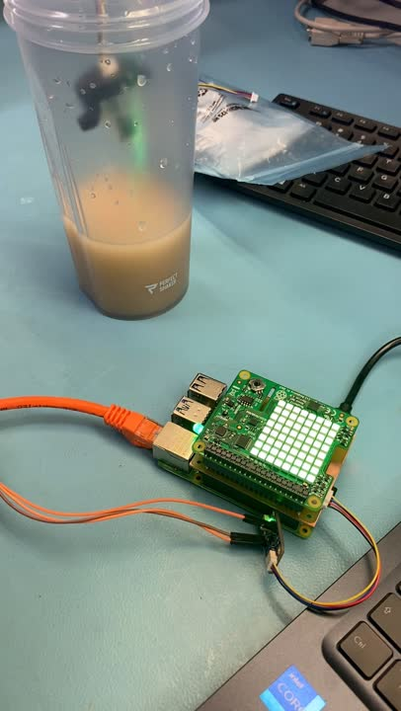
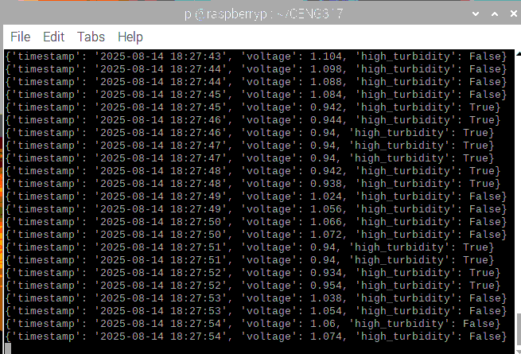
THE VIDEO DEMO

Slide 10
CHALLENGES AND LESSONS LEARNED
Soldering Problems with the groove connector broke off, cold solder.
i2c Address recognition problems (0x48) related to groove connector.
Connections between ADS1015 and SEN0189 (VIN, GND, A2)

Slide 11

HARDWARE PRODUCTION TECH - CENG-317-0CA
THANK YOU!
WWW.MYSENSOR.COM

